Slide 1
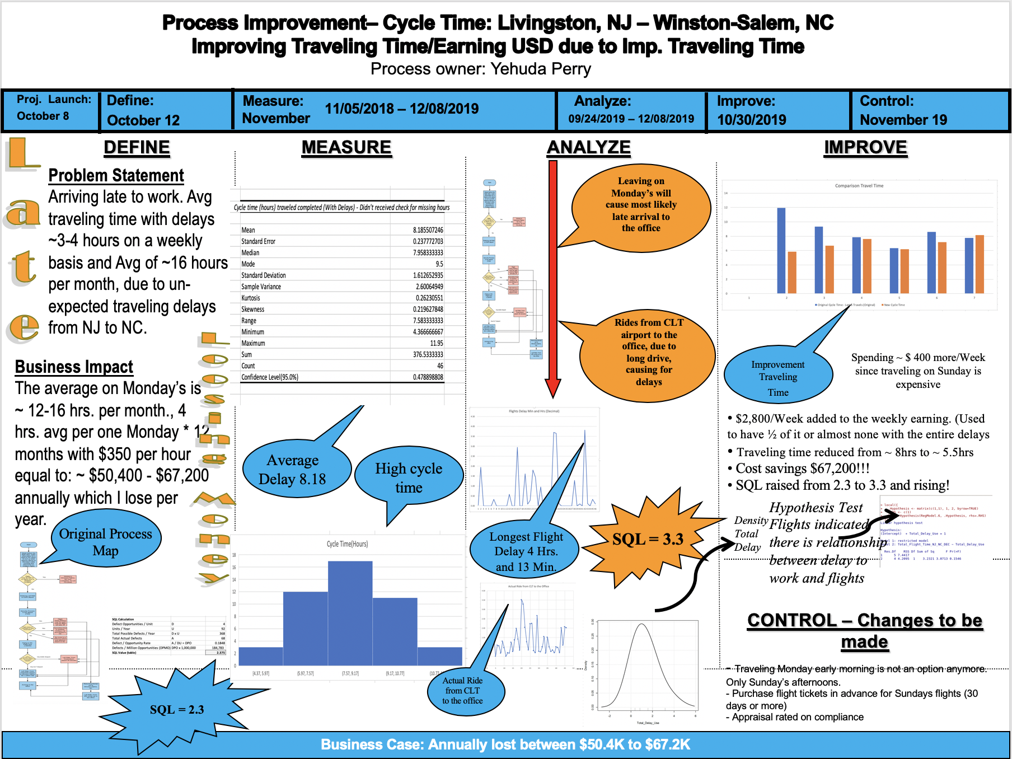
Story Board

Slide 2

12/14/2019 Yehuda Perry
Livingston – WS
Improve Traveling Time

Slide 3
Introduction
Two Datasets: Diff. Calculations
Tools: Excel R and Python
Data Cleansing and Scrubbing Administered
Analysis: Dataset Statistic Summary, Frequency Distribution – Delay, Linear Regression Analysis, Correlation Matrix, Normality Test, Variables Correlation Test, Numerical Summary, Initial SQL (Sigma Quality Level), Final SQL, Cycle Time, Multiway ANOVA, K-Mean Analysis, Hierarchical Cluster, Single Sample t-test, Sample Size, Hypothesis Test, HT - Type 1, Chi-Squared Distribution, Exponential Distribution, Control Chart.
Data Collection: Data was collected from: AA App, United App, Personal Records, Lyft App, Personal Income Statements, Invoices.
Overview of Presentation:
Datasets
Visualizations
Models
Conclusions

Slide 4
Datasets & Tools
2 Datasets --> One Dataset use for excel calculations & visualizations and one dataset used for R calculations and visualizations
The dataset describes traveling incl. costs between Livingston, NJ to Winston-Salem, NC (Traveling from home to work)
Train Dataset : 61 attributes, 58 rows
Tools I used: Excel, R and Python

Slide 5
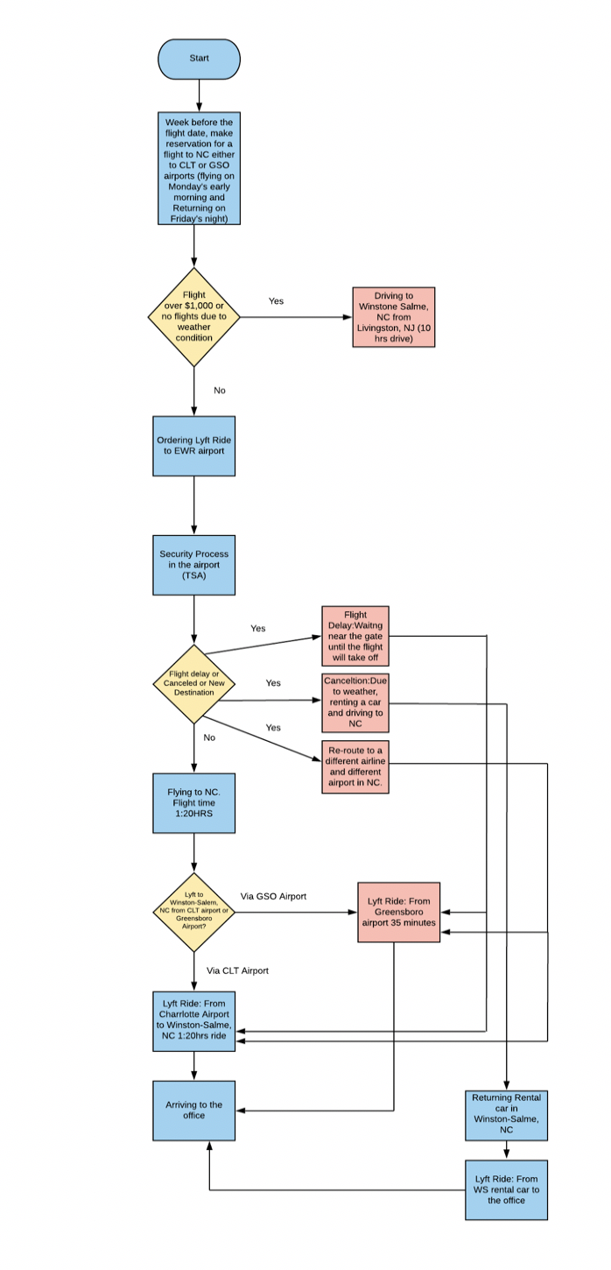
Original Process Flow Chart
In the original process I left to work on Monday’s early morning to be in WS @ 08:30am.
As a result and most of the time, I didn’t arrive on time on Monday’s, which lead for ~ $67.2K/year.
The original process describe root causes in multiple points: Airlines Delay, Lyft Delay to the destination from the airport, Security Delay.
Analyzing the process flow chart, suggesting to improve the current process.

Slide 6
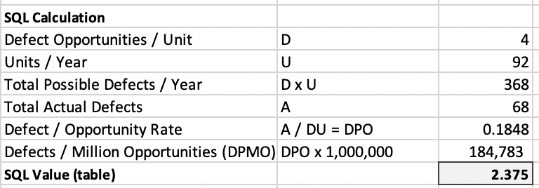
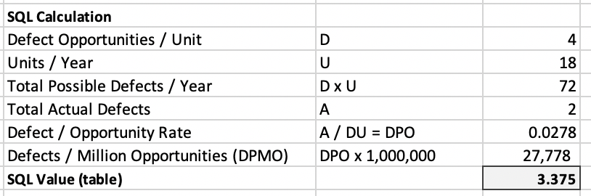
Original Process: Sigma Quality Level (SQL)
Original Sigma Quality Level (SQL)
New Process: Original Sigma Quality Level (SQL)
The original process have an SQL of: 2.375 Vs. the new process that have 3.375.
Improvement!!! Total actual defect improved!
Possible Defect: Airline Delay due to weather, machinal issues, long security lines, Lyft late arrival.

Slide 7
Data Measurement Plan

Slide 8
Data Collection Method
The data collected in several methods:
American Airlines Application Records: AA application assist me to track and understand better the delays, taking off time and duration, flight time, arrival to destination, expected delays, reasons for delay, flight costs and reduce measurement errors by using the time stamps for each attribute.
United Airline Application Records: Same as American Airline
Lyft Application Records: Tracking my trips, Costs, Ride Time, Ride Arrival to destination, estimated ride time and help to reduce measurement errors by using the time stamp for each attribute.
Personal memos and Records collected by me: Checking in time, TSA duration, Waiting at the gate, Waiting for Lyft Ride.
Notes:
We dropped the City variable as there was a higher pValue than we wanted.

Slide 9
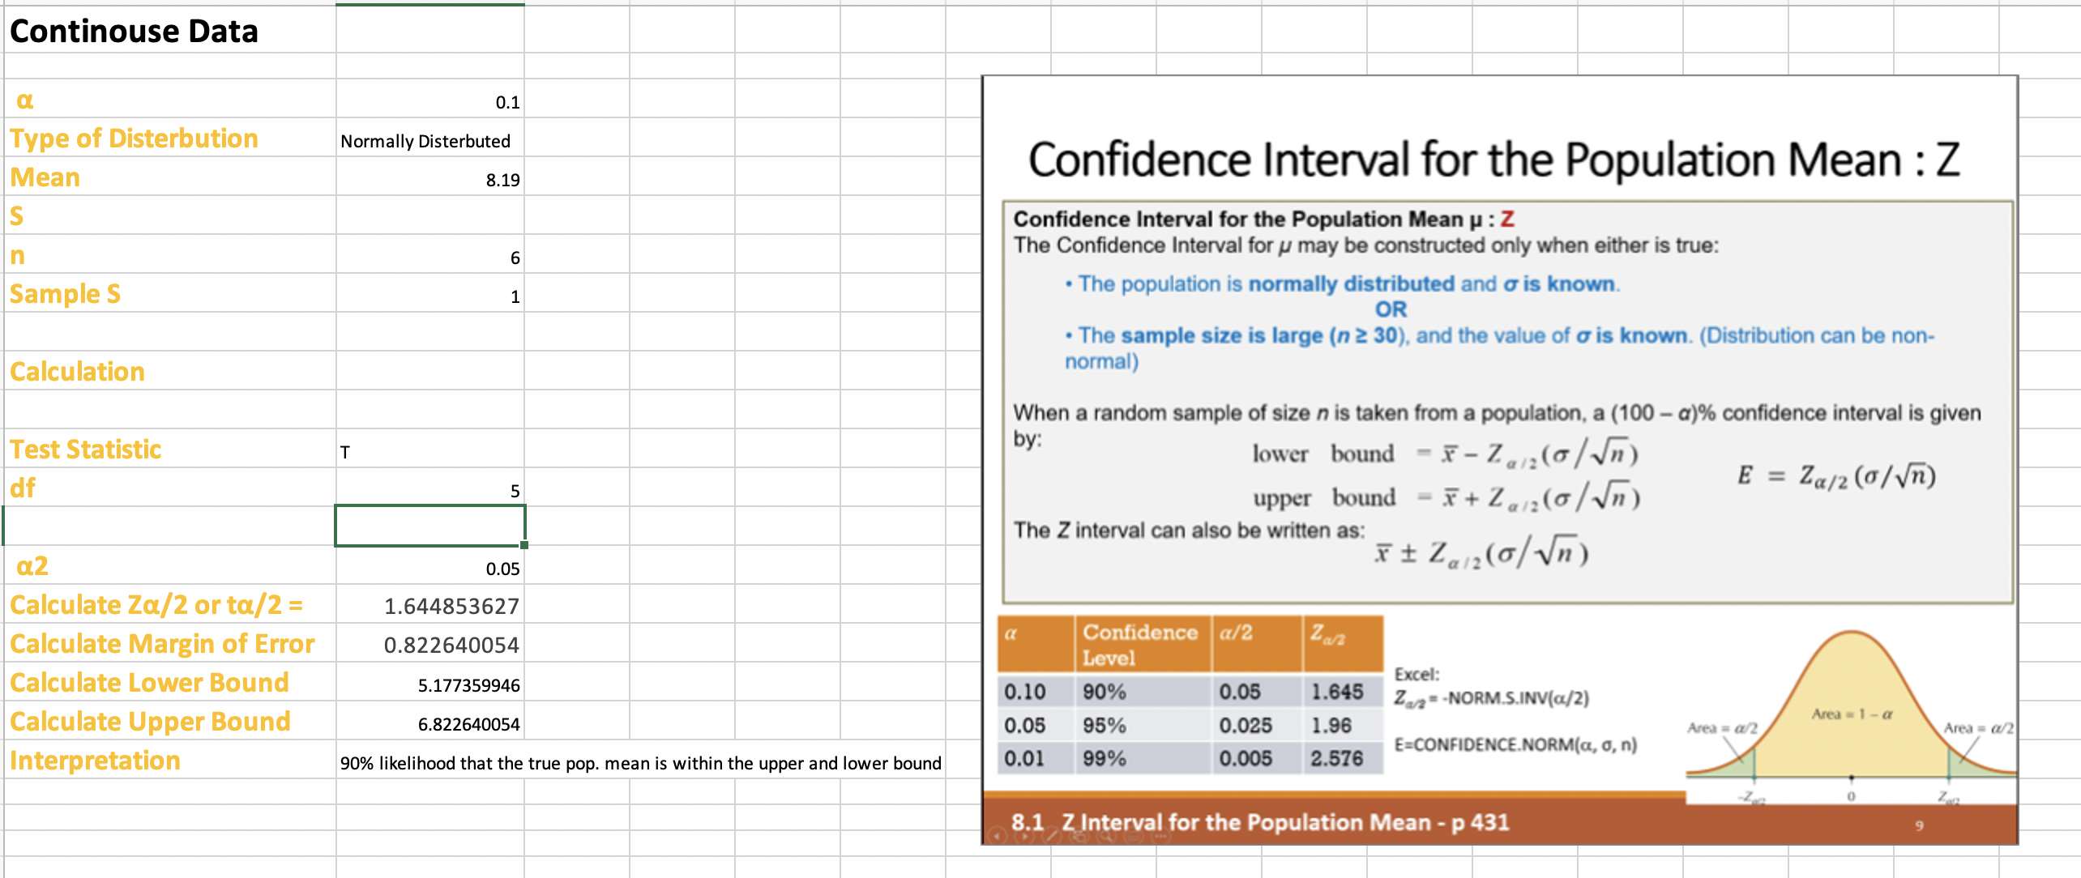
Sample Size
Type of distribution: Normally distributed
The sample based on the new process with SD of 8.19 and using an alpha of 0.05 I am about to accept margin error of 0.822
Summary: By taking 6 samples from the new process, I will be 95% sure of TT.

Slide 10
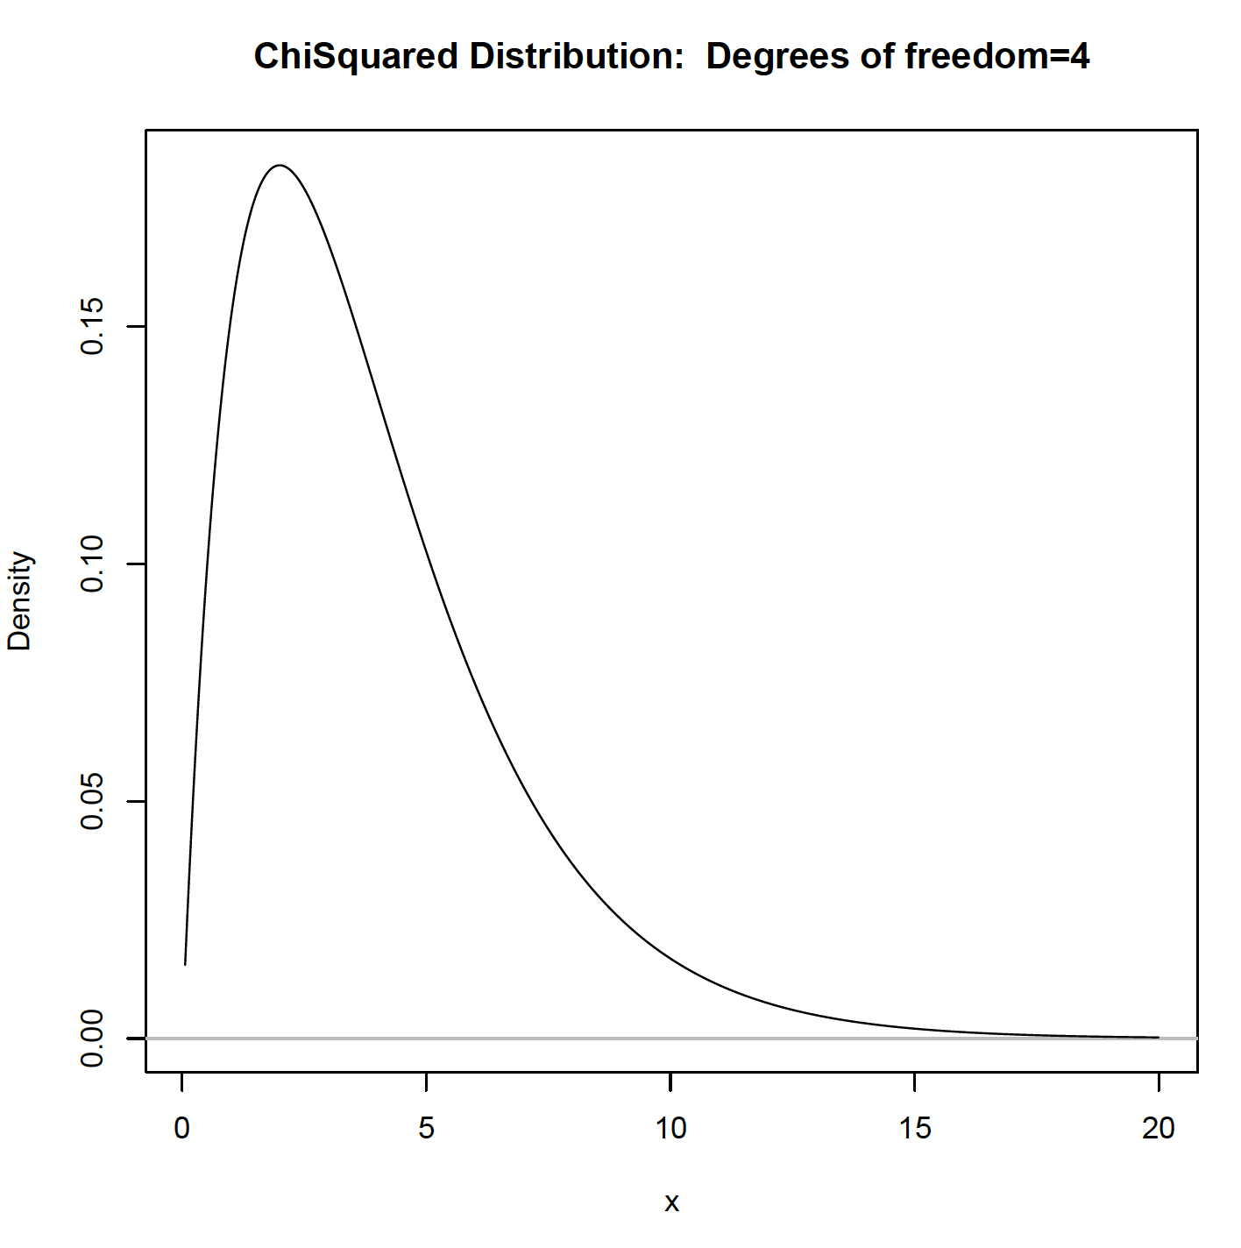
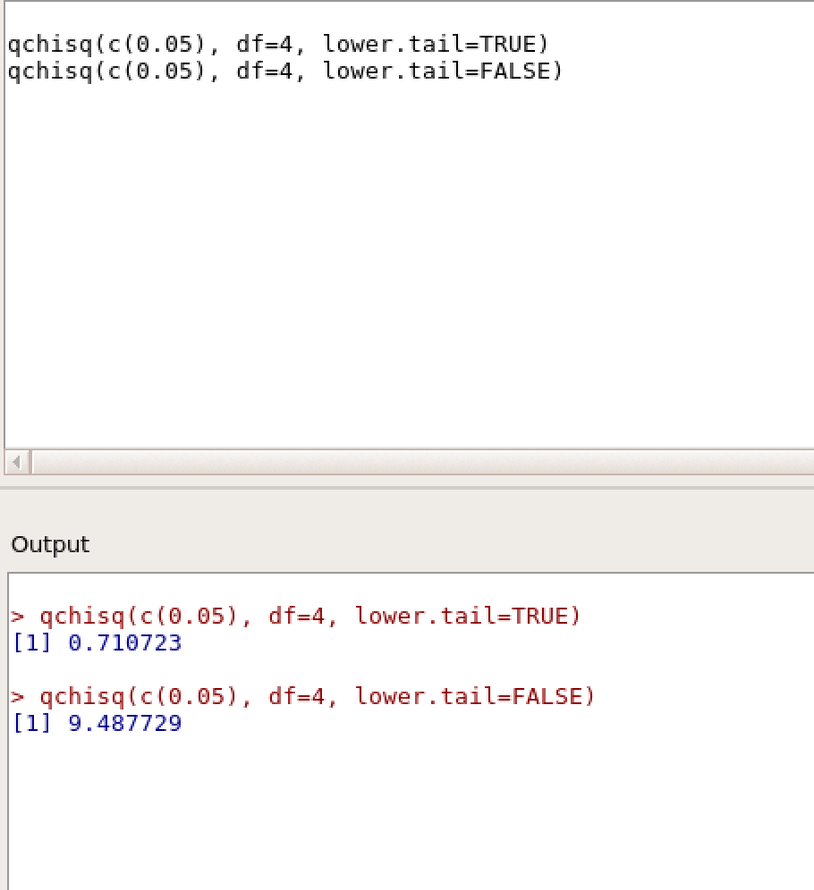
Chi-Square Test
The chai-Square indicates that there is a relationship between all delays to airlines delay. Recommended either to change airline or flight time. Chi-Square received from R calculations: 9.487729
The chart describes the Chi-Square distribution.
Conclusion: Rejecting the null.

Slide 11
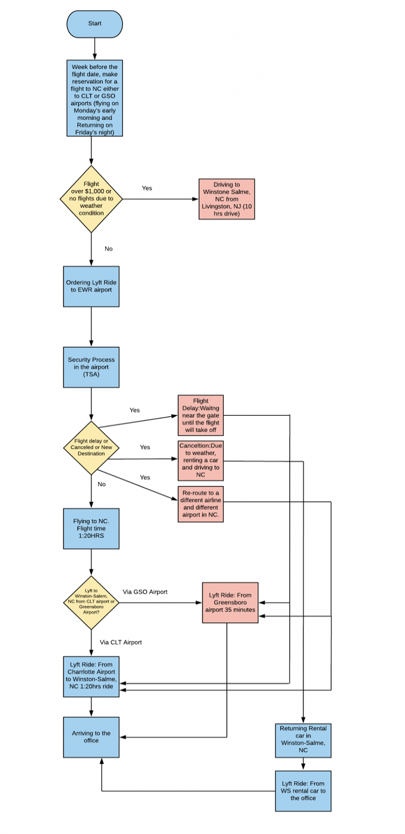
New Process Flow Chart
The new process flow chart changed as follows:
Traveling will be on Sunday afternoon instead of Monday’s early morning
Any other processes stays the same except making the traveling date to Sunday

Slide 12
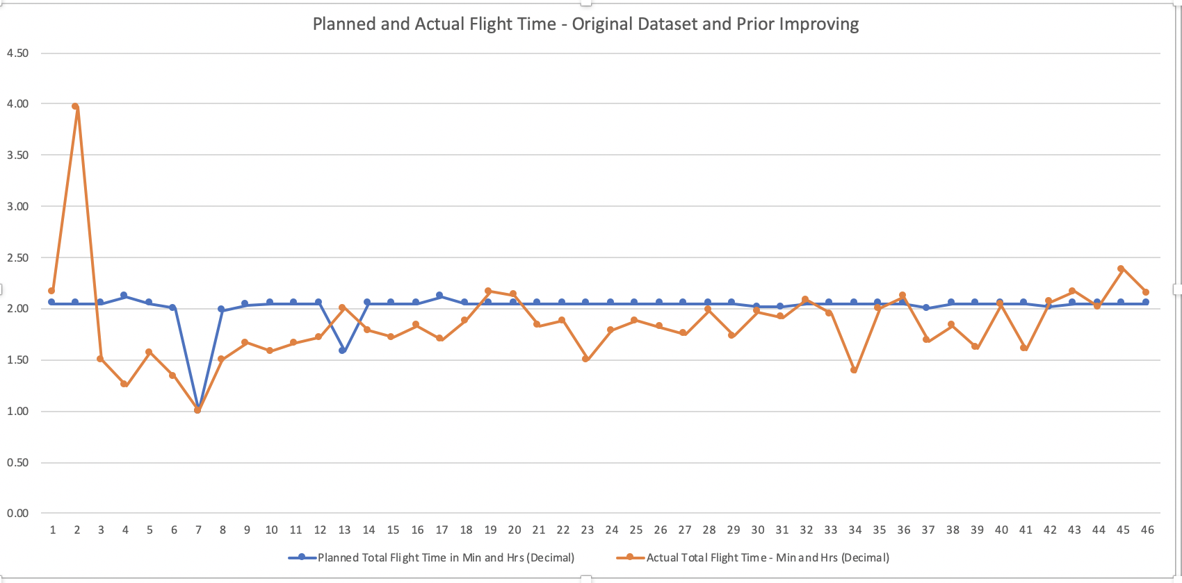
Visualization: Planned and Actual Flight Time

Slide 13
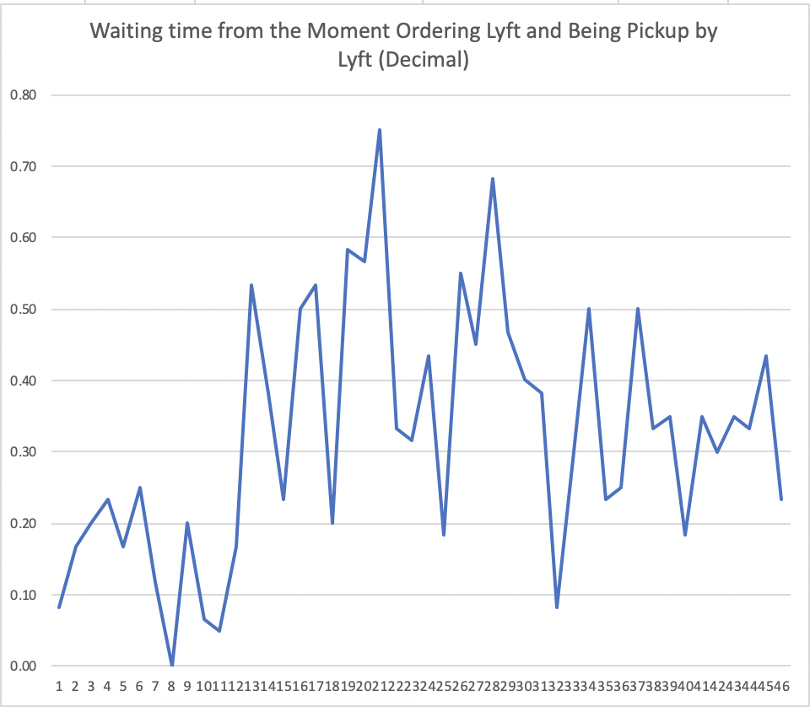
Visualization: Waiting Time Lyft

Slide 14
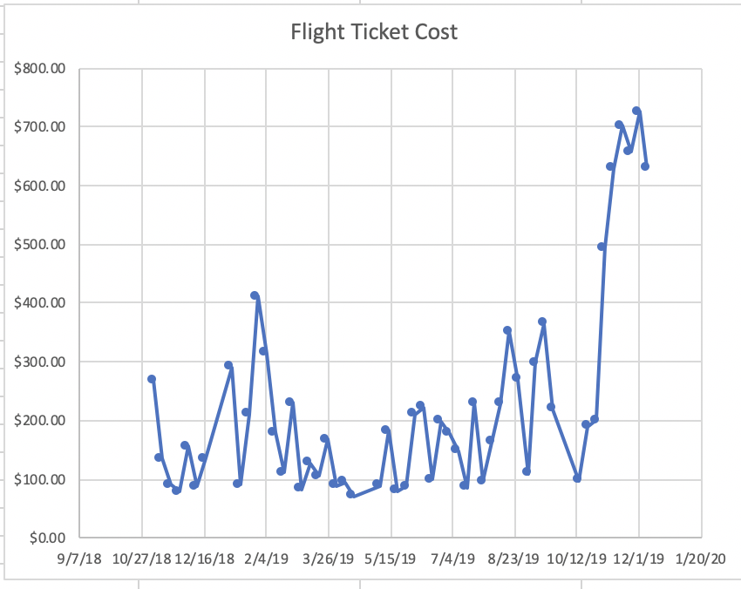
Visualization: Flight Tickets Costs
Flight ticket cost more after changing to Sunday flight but it’s still worth it…

Slide 15
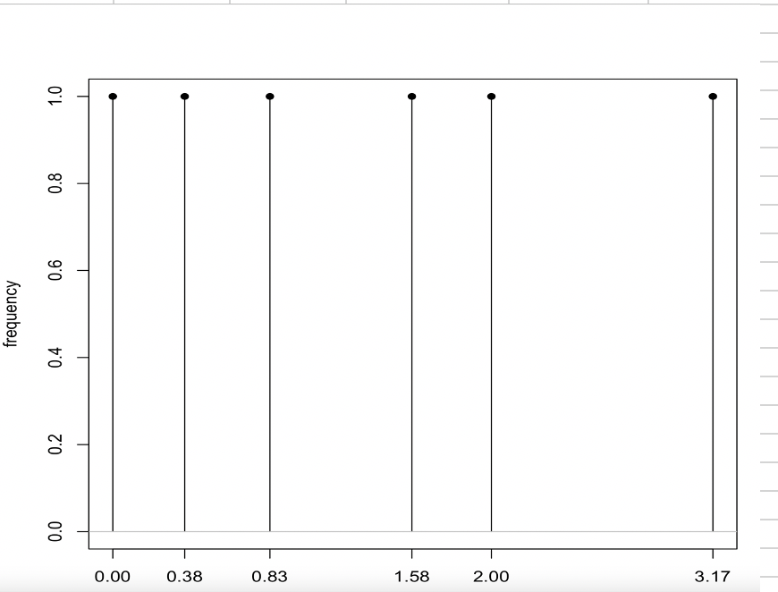
Visualization: Total Delay Frequency

Slide 16
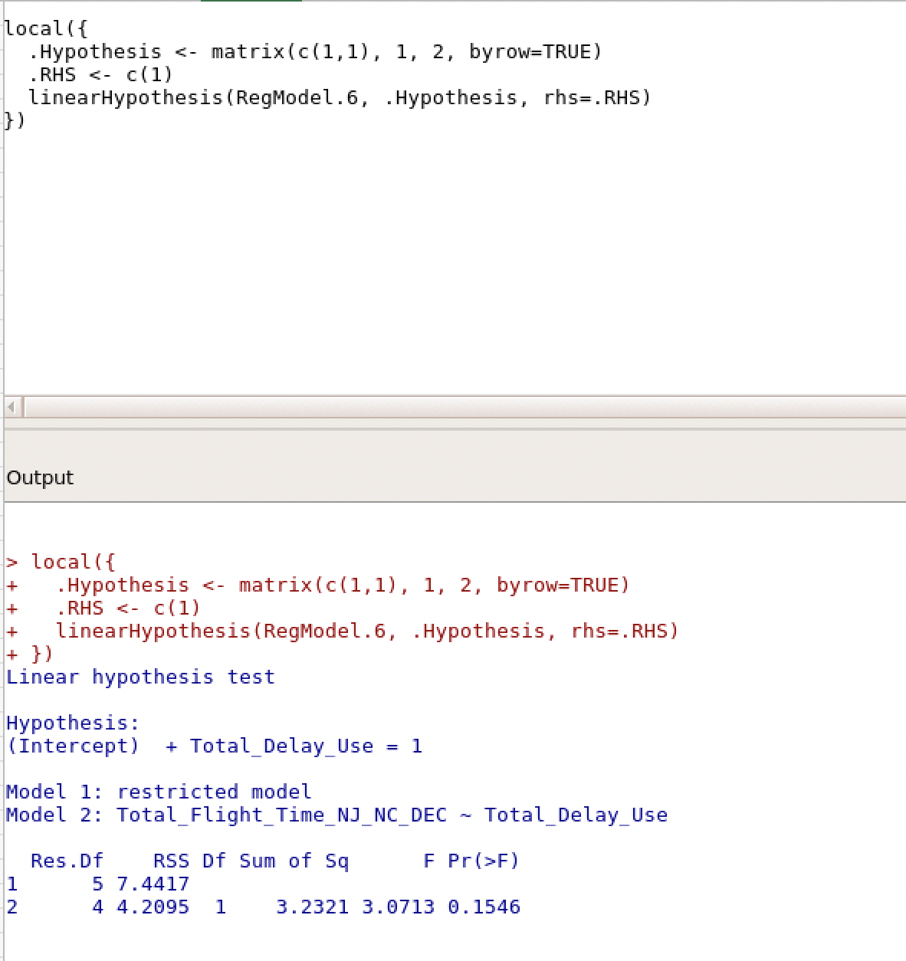
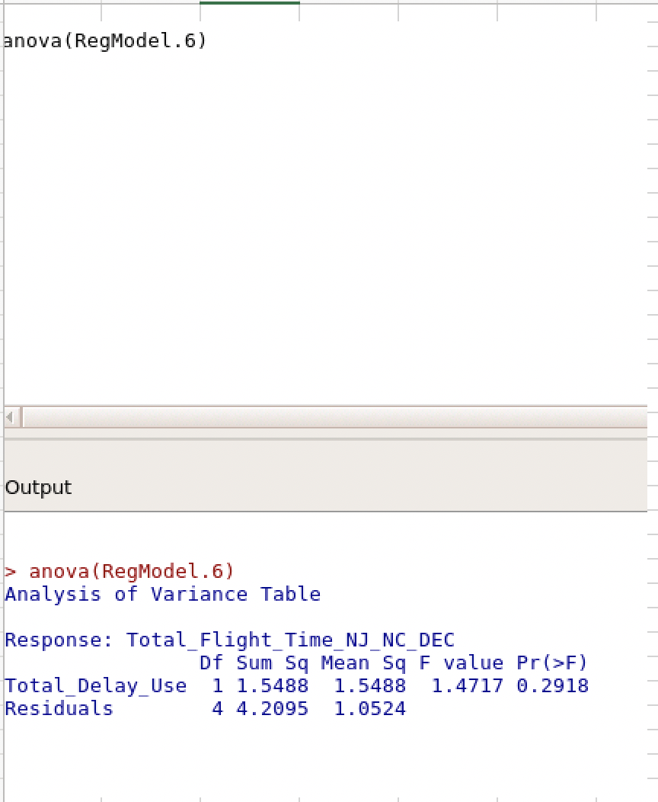
Hypothesis Test
The Hypothesis Test rejected the null hypothesis.
Based on the information collected, I can conclude that the new process will effect on the arrival time to the office.
Ha: The new process will have an effect on the arrival time.

Slide 17
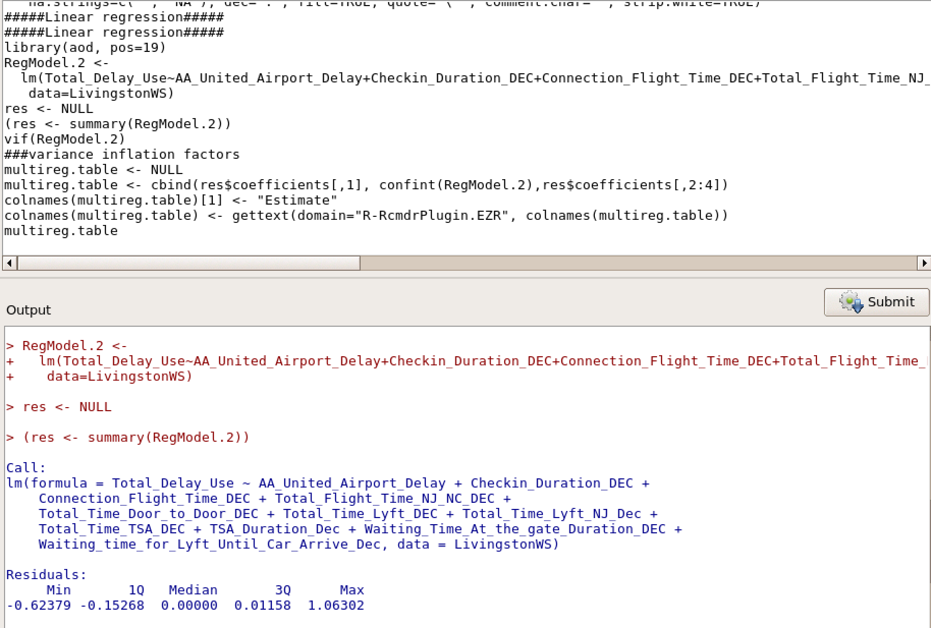
Linear Regression

Slide 18
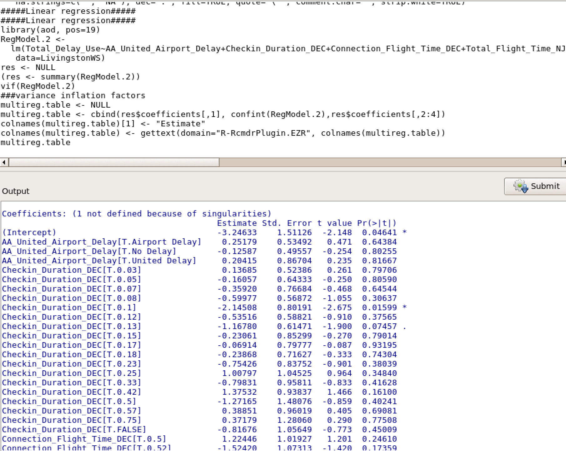
Linear Regression

Slide 19
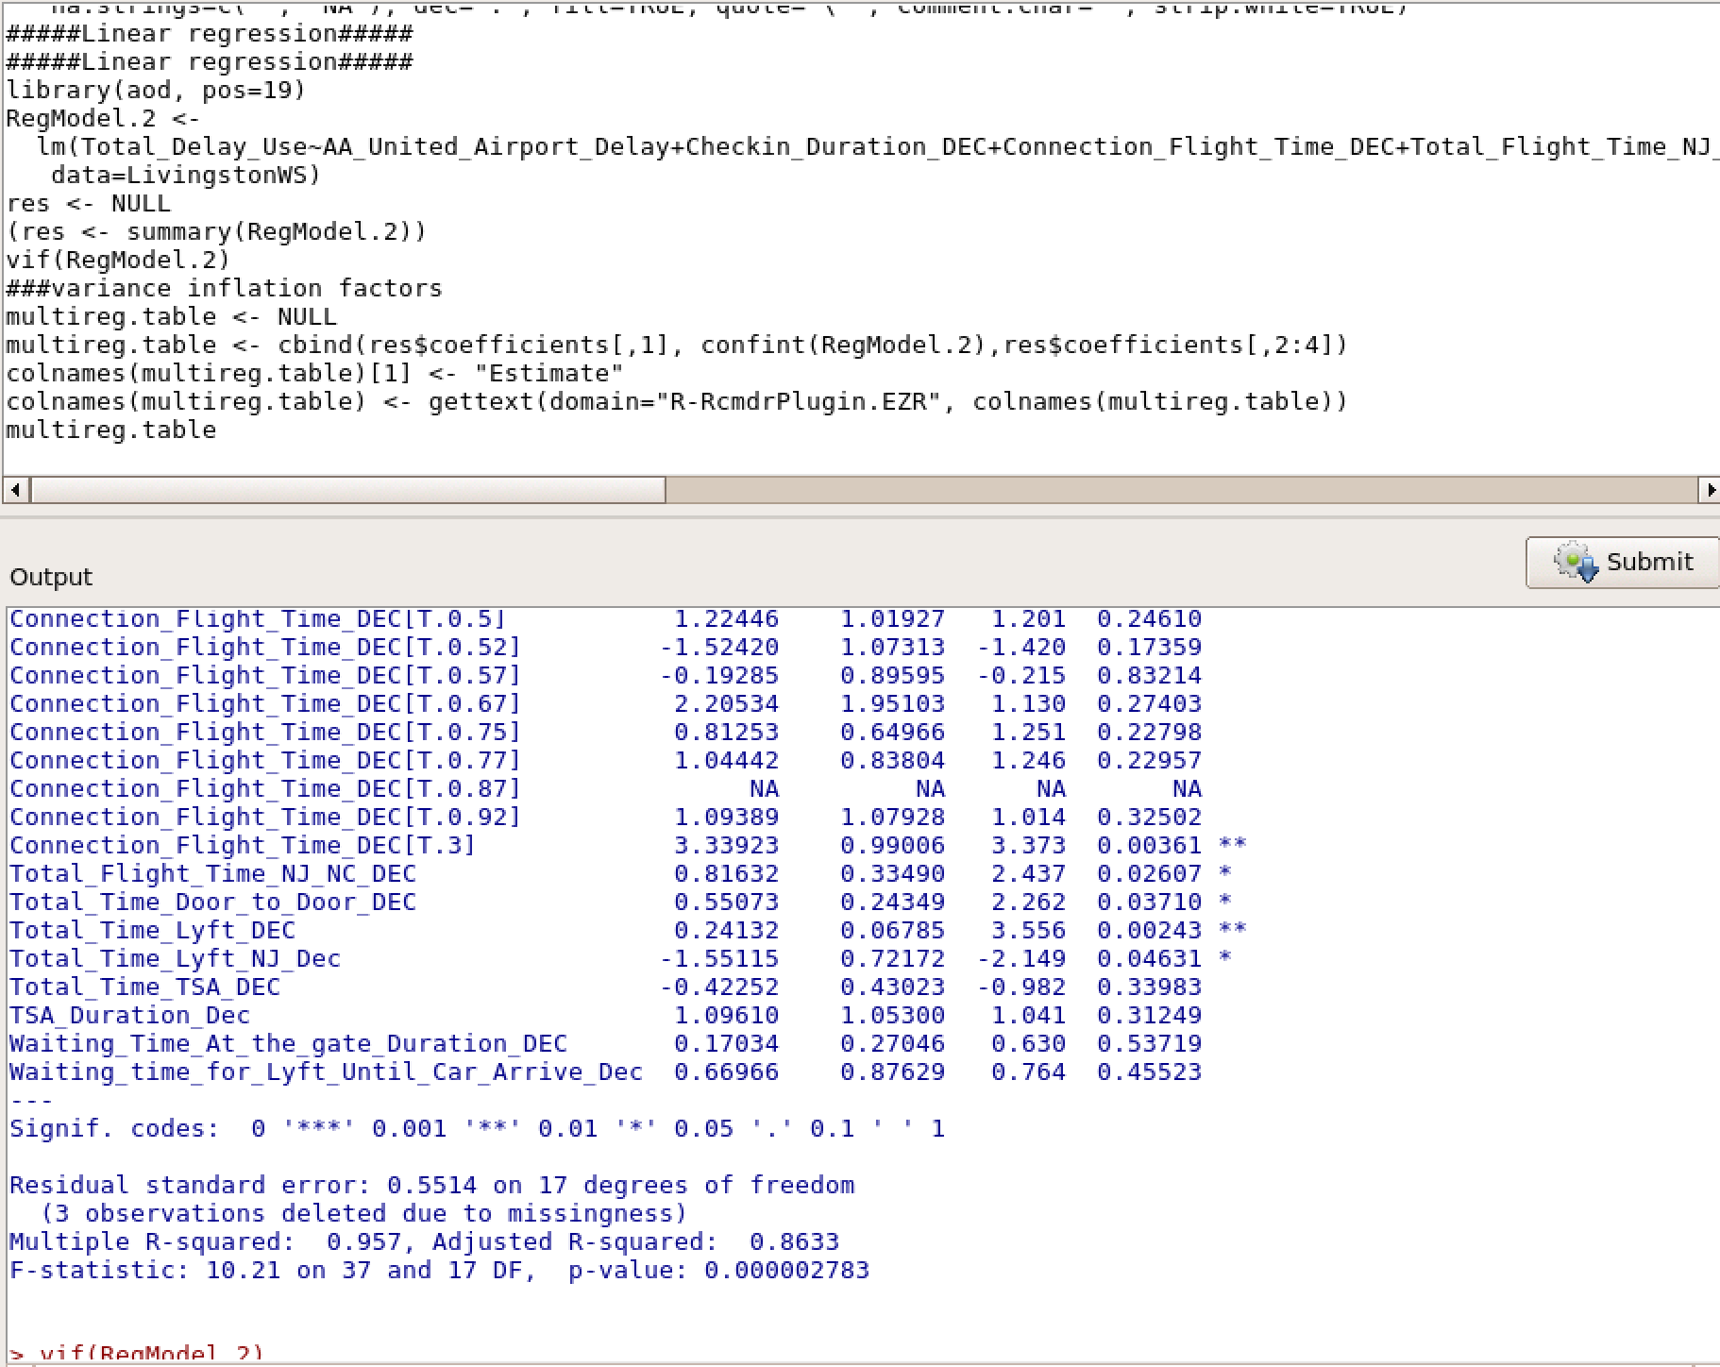
Linear Regression

Slide 20
Linear Regression
R-Square: 0.957
Adjusted R-Square: 0.8633
There is relationship between the dependent and independent variables. Amazing! ;-)
P-Value is less >0.05

Slide 21
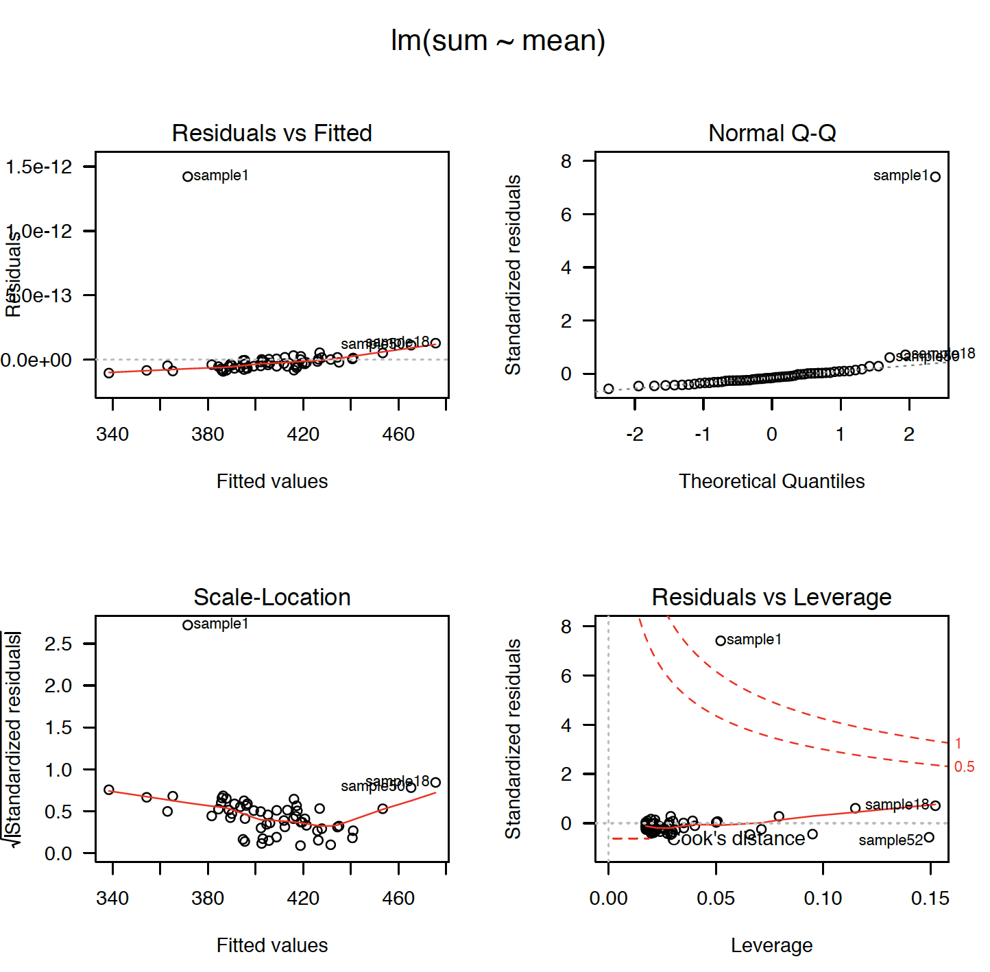
Linear Regression – Diagnostic Plot I

Slide 22
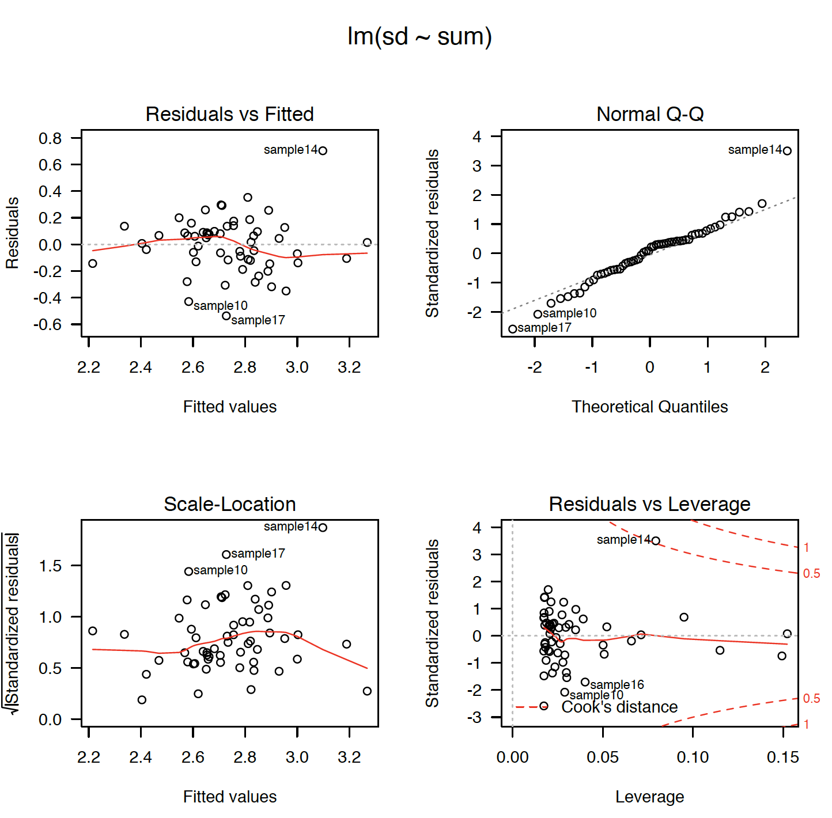
Linear Regression – Diagnostic Plot: II

Slide 23
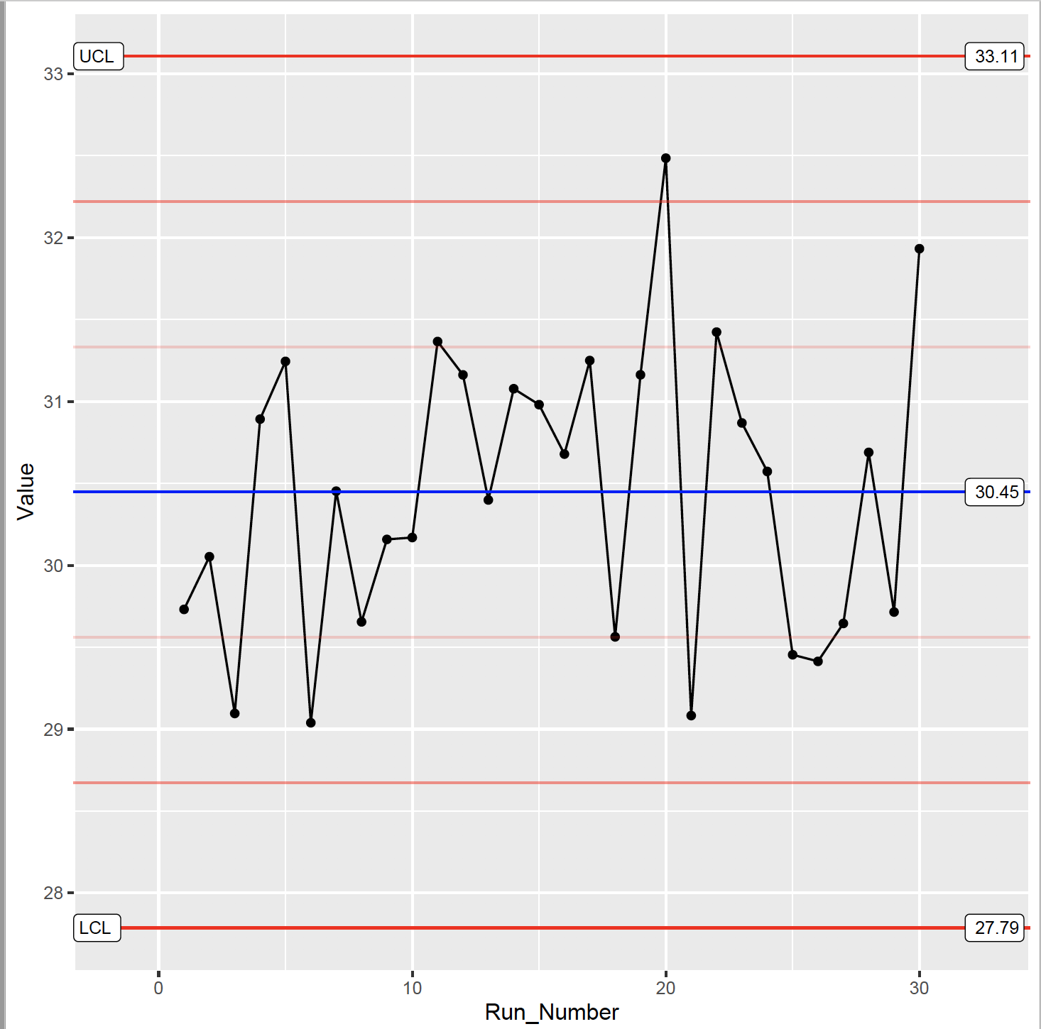
Control Chart
R-Square: 0.957
Adjusted R-Square: 0.8633
There is relationship between the dependent and independent variables. Amazing! ;-)
P-Value is less >0.05
Control Chart is in Control → Process in Control!

Slide 24
Conclusions
The new process save ~3.5 traveling time
The new process have a Sigma Quality Level of 3.375
It was proven there is a strong correlation between total delays and Airlines delays
The decision to move my flights to Sunday night have been accepted and Monday’s morning are off the table…
By arriving 12 hours prior to WS, I succeeded to earn between ~$50.4 and $67.2 yearly.
Yehuda will continue to monitor the process by checking the control chart on a monthly basis.
Important: In order to support my decision, I examined additional statistical which can be reviewed in the excel.

